Slide 1
Industries along the River Darent/Darenth
Sue Christy February 2014

Slide 2
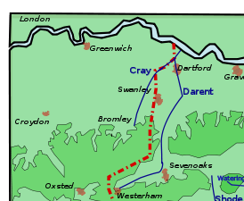
Numerous mills along the Darenth
Mills from Sevenoaks –Dartford at Dartford(6)
Sutton at Hone (3)
Horton Kirby (2)
Farningham
Eynsford
Shoreham (2)
Otford
Dunton Green
Mills from Westerham-Sevenoaks
at Westerham , Valence, Brasted, Sundridge, Chevening

Slide 3
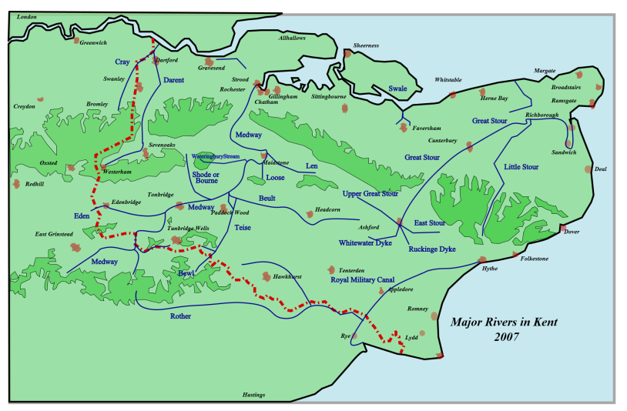

Slide 4
Westerham -Sevenoaks Mainly corn mills or water pumping
Westerham Elm View mill: corn
Darenth (Tower Wood) mill: corn
Squerries Spring Shaw mill: corn
Valence pump, Brasted: water pumping
Brasted mill: corn
Sundridge mill: paper making, then laundry
Chipstead mill, Chevening: roller milling plant

Slide 5
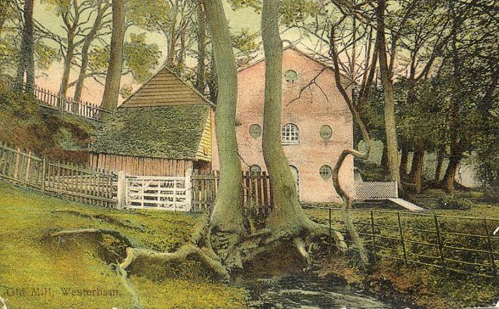
Westerham Mill, ca 1912
Corn mill originally,
converted to pump water to Westerham in 1890
Notes:
The miller at this corn mill in 1771 was James Marchane, who was joined by his son James. James Jr died in 1805 and James Sr died c.1812. The mill was sketched by G. Samuel in 1818. It had an overshot waterwheel.^{[3][10]} The cast iron overshot waterwheel was 12 feet (3.66 m) by 2 feet 9.5 inches (0.85 m). It was fitted in 1868, replacing a wooden wheel which may have been breast shot. In 1890, the waterwheel was adapted to drive a set of pumps to supply Westerham. An average of 25,000 imperial gallons (110,000 l) could be supplied. The milling machinery was removed in 1936 and during the Second World War a doodlebug landed nearby and blew the roof of the mill off. The derelict building stood in April 1954, but had been demolished by July 1960.^{[11]}

Slide 6
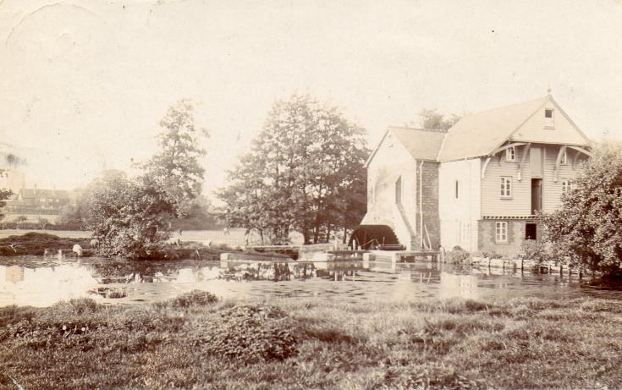
Brasted Mill, ca 1906
Corn mill originally, now a house

Slide 7
Sevenoaks-Dartford More corn mills and some industries
Dunton Green, Longford mill: corn
Otford mill: corn mill, then saw mill
Shoreham, upper mill: corn
Shoreham, lower mill: fulling, then paper mill
Eynsford, Wood mill: corn and/or saw mill
Farningham mill, corn, then saw mill

Slide 8
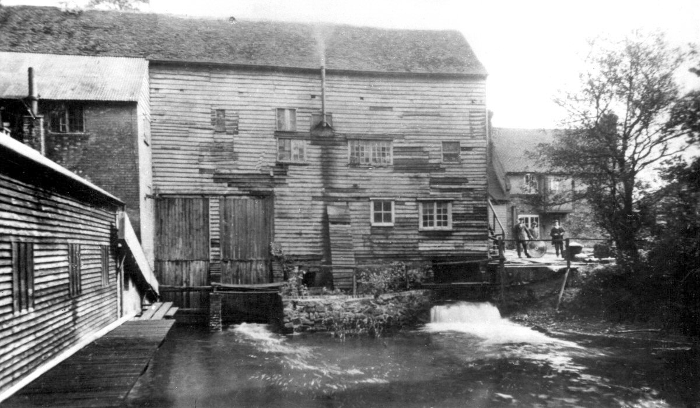
Otford mill
Originally, a corn mill , later a saw mill
Burnt down in 1924

Slide 9
More industry close to Dartford
Horton Kirby:
Westminster mill: corn, electricity, shoe laces, housing
Paper mill: once two corn mills and a forge. Paper from this mill used for the Tatler
Franks generating station; late 19th century, electricity for Franks Hall
Sutton at Hone
Frog Lane mill: corn
Old mill farm: corn
Hawley Mills: wheat mill, paper, gunpowder;
malt mill, iron rolling and splitting mill, paper
South Darenth mill: roller milling plant
Darenth: paper mill

Slide 10
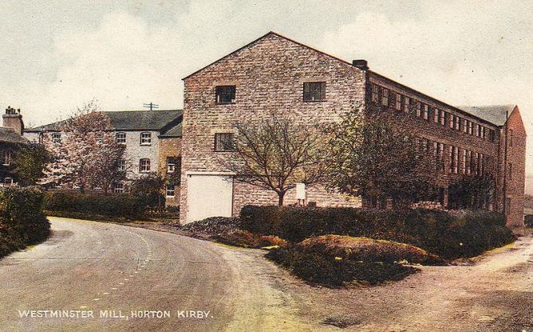
Westminster Mill, Horton Kirby
Originally, a corn mill standing upstream of a paper mill.
Then, turbine replaced waterwheel to generate electricity.
Mill burnt down in 1908; rebuilt as a factory making shoe laces. Factory closed in 1991, the mill has since been demolished and site redeveloped for housing
Notes:
This was a corn mill which stood upstream of the paper mill. Henry Knight was a miller in Horton who died in 1724 and Thomas Welch was a miller in Horton who died in 1734. George Cannon took the mill in the early 1830s. In 1843 he was bankrupt as a common brewer, an occupation he carried on along with the mill. Ill health forced his retirement in 1852, and the mill was bought by his brother Stephen. His son, also Stephen, was running Old Mill from 1850, then being 14 years old. Stephen Cannon (father) died in 1872 and Stephen Cannon (son) sold Westminster Mill and Old Mill in order to concentrate the milling business at a mill in Bexley. Latterly the waterwheel was replaced by a turbine and the mill generated electricity. The mill burnt down when struck by lightning in 1908 and was rebuilt as a factory which made shoe laces. The factory closed down in 1991 and the mill has been demolished and the site redeveloped as housing.^{[3][4][21][22][23][24]}

Slide 11
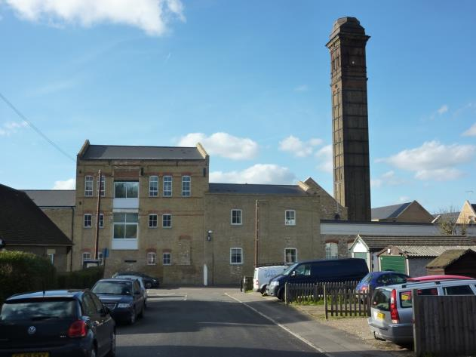
Chimney at Horton Kirby Paper Mill

Slide 12
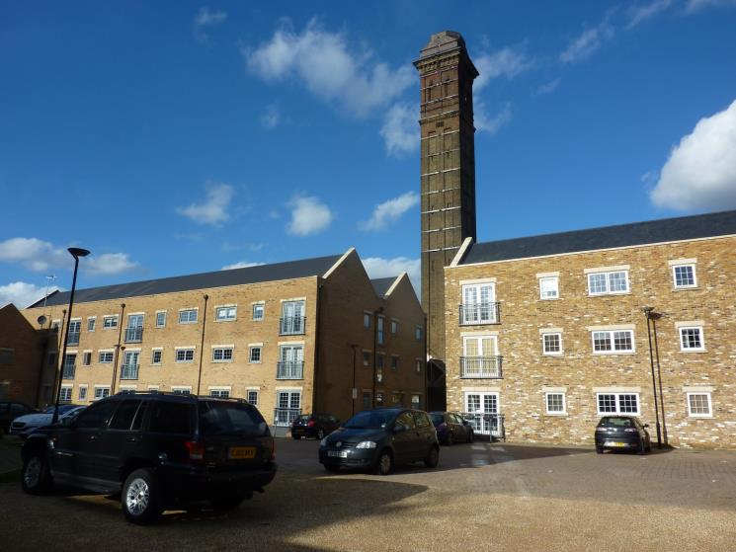
Old buildings, new uses

Slide 13
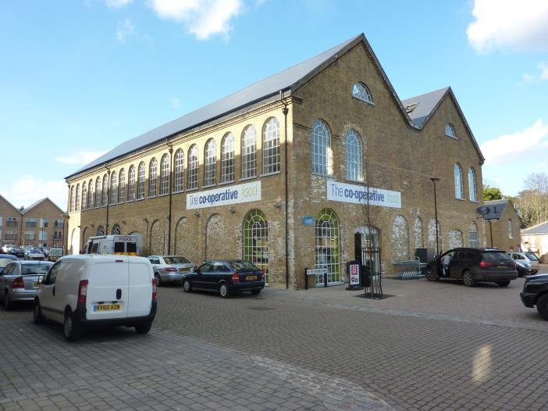
Old buildings, new uses

Slide 14
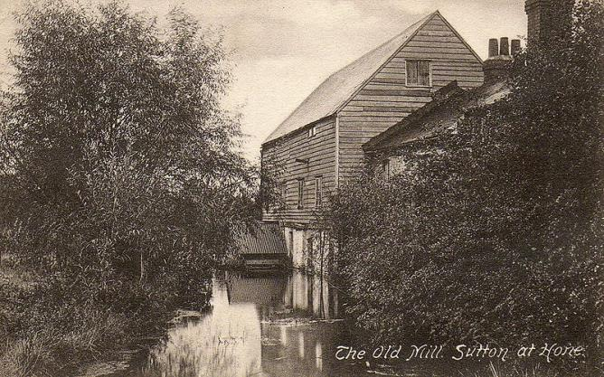
The Old Mill, Sutton at Hone
This corn mill stood at Old Mill Farm. It was built in the early 19th century. Latterly the mill had a steam engine and a tall chimney.
During the First World War, a bomb hit the mill, but did not explode, although the mill was put out of action. Demolished in September 1928.

Slide 15
Dartford industries

Slide 16
Darentfort = Dartford
Saxon communities established in and around Dartford
Domesday book entry includes a mill and two wharves at Darentfort (agricultural, 150 families)
Medieval Dartford 1000-1500: thriving and successful market town on main road from London to Canterbury and Kent coast. Population 1000. Industries: milling, fulling, lime burning, tile making, chalk mining
1500-1600: trade, commerce and industry increasingly important. A period of instability and inflation from which Dartford benefited Geographical position and natural resources attracted pioneering new industries: Sir Martin Frobisher’s smelting works, Sir John Spilman’s paper mill, Godfrey Box’s iron-slitting mill and others to create an early mini ‘industrial revolution’
Notes:
The Domesday Book entry for Dartford compiled by the Norman invaders in 1086 reveals that the royal manor of TARENTFORT (Dartford) was a small but thriving agricultural community supporting a population of approximately 150 families. The manor of Dartford comprised a mixture of arable land, meadow, pasture and woodland. Other features of note were the parish church, Holy Trinity, three smaller chapels, a mill, and two wharves on the River Darent. Teams of oxen were used to plough the land; pigs foraged in the local woods.
The years 1000-1500 saw a remarkable transformation in the size and importance of this former royal manor. Dartford evolved into a thriving and successful medieval market town supporting a population of approximately 1,000 people. The town’s new status arose from its position on the main road from London to Canterbury and the Kent coast, and its close involvement with trade and commerce. Dartford became an important market town at the centre of a network of smaller agricultural communities scattered along the fertile Darent Valley and along the south bank of the River Thames
1500-1600 period of instability and inflation. Dartford benefited. Dartford’s geographical position and natural resources attracted a number of leading entrepreneur industrialists to establish pioneering new industries in the area. Sir Martin Frobisher’s smelting works, Sir John Spilman’s paper mill, Godfrey Box’s iron-slitting mill, and other less prominent manufacturies created a mini ‘industrial revolution’ at a time when many other similar towns were still relied on an agriculturally based economy.

Slide 17
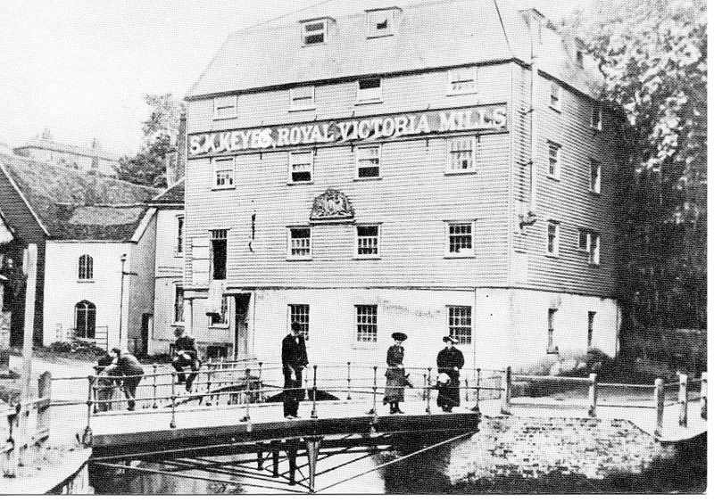
Victoria Mills, Dartford
Mills stood on the site of a 15th-century fulling mill and an old wire mill, mentioned in 1570 as a glazing mill, used for polishing armoured plate.
In early 19th century there were three mills here; an oil mill, a mustard mill and a corn mill – this a four storey wood structure built in 1790.

Slide 18
Papermaking
The Hammers thump and make so loud a noise As fuller doth that beats his woollen cloth In open show, then Sundry secret toyes Make rotten rags to yield a thickened froth There it is stamped and washed as white as snow Then flung on frame and hanged to dry, I trow Thus paper straight it is to write upon As it were rubbed and smoothed with slicking stone
Britain’s first commercially successful paper mill established in 1588 (Hawley Mills, Sutton at Hone), making highly prized white paper
Set up on the site of earlier mills by John Spilman (Spielman), a German entrepreneur who became 'Goldsmyth of our Jewelles ' to Elizabeth I and James I.
Monopoly position by manipulating the favour and patronage of successive monarchs
A patent dated February 1589 granted Spilman the monopoly of buying or dealing in linen rags, old fishing nets and leather shreds '… fitt for making all sorts of white paper.
Nobody else was permitted to build a paper-mill without Spilman's consent. Employed 600 men, mainly Germans
Company of white paper makers established there in 1694
Became a gunpowder mill ~1739
A paper mill again by 1840, owned by Mr Wiggins
Dartford was very important for paper making through the centuries

Slide 19
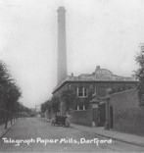
Telegraph paper mills, Dartford
Photo from Dartford museum

Slide 20
Iron rolling and slitting mill
Malt mill at Hawley mills leased by Spilman to Godfrey Box of Liege (1590-1595)
First in England iron rolling and slitting mill for manufacturing nails
By 1758; two waterwheels
upper roller
lower roller and guillotine

Slide 21
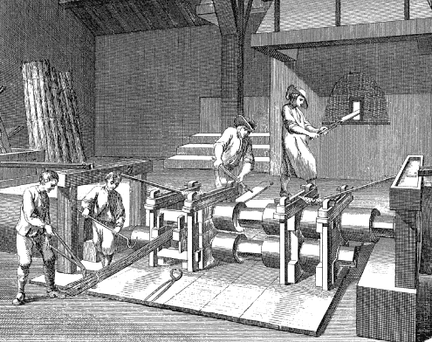
Slitting mill for manufacturing nails
Notes:
The industry was made possible by the invention of the slitting mill in 1565. This was a watermill, where bars of iron were slit into rods which were passed to nailers, who made them into nails by adding a point and a head. The slitting mill was probably invented in Belgium, and first appeared in England in 1590 at Dartford in Kent.
The slitting mill had two sets of water-powered rolling mills to convert flat bars of iron, about three inches wide and half an inch thick, into rods. Pieces were cut-off the bars by shears powered by a waterwheel, then heated in a furnace before passing between flat rolls to produce a sheet of the required thickness.
The sheet then passed through the second rolling mill where cutters with intersecting grooves slit it into rods.
An impression of a local backyard nail shop can be obtained from the the nail shop at the Black Country Living Museum. It has a typical hearth, but the nails are hand-forged without the use of an 'oliver'.

Slide 22
Failed smelting for gold established smelting industry
Elizabethan explorer Sir Martin Frobisher launched three expeditions to Arctic Canada in the 1570s searching for a North West Passage to China.
Black ore, thought to contain large quantities of gold shipped to England
A prototype smelting works, on a site of a wheat and corn mill. constructed in 1577 by two Dutchmen.
Smelting house contained mill wheels, stamping mills, three furnaces and three pairs of bellows. Cost of construction work was ~£900.
Smelting took place at Dartford in January and February 1579.
Little gold extracted and investors lost considerable sums of money.
The beginning of a long tradition of specialised industrial activity along the Darenth valley; most notably paper, gunpowder, fabric printing, and manufacture of iron, brass and zinc.
Notes:
Elizabethan explorer Sir Martin Frobisher launched three major expeditions to Arctic Canada in the 1570s searching for a North West Passage to China.
Black ore, thought to contain large quantities of gold shipped back to England for smelting.
Dartford selected in ~1577 for the construction of a prototype smelting works, close to modern-day Powdermill Lane, on a site of a wheat and corn mill owned by William Vaughan, a founder of Dartford Grammar School.
Two Dutchmen constructed the smelting works. The River Darent had to be dammed and building materials imported from all over the south east.
Smelting house measured 24 x 36 ft. It contained mill wheels, stamping mills, three furnaces and three pairs of bellows. Cost of construction work was ~£900.
Thirteen of Frobisher’s ships returned from the 3rd expedition in October 1578.
Smelting of this ore took place at Dartford in January and February 1579.
Total amount of gold extracted from the ore was surprisingly low. Many investors in the venture, including Elizabeth I, lost considerable sums of money.
Nevertheless, establishing a unique smelting works at Dartford was the beginning of a long tradition of specialised industrial activity centred on the River Darent.
It created a mini ‘industrial revolution’ along the Darent Valley, most notably in paper making, gunpowder manufacture, fabric printing, and manufacture of iron, brass and zinc.

Slide 23
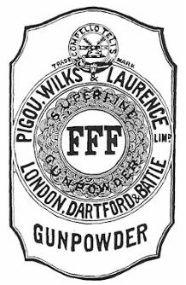
Gunpowder
Started first half of 18th century
Dartford had ample water supplies for making black powder and for driving machinery
4 mills in 1790, by 1810, the most extensive powder magazines in England.
Saltpetre from India and Italy, sulphur from Italy and Sicily and charcoal from local alder and willow
On-site special processes: gunpowder was milled, dried, granulated, polished and packed.
Mills were surrounded by large earthen embankments to minimise damage from accidental explosions.
Regular explosions, the most serious in 1745, also in 1790, 1796, 1799.
1796, a new road built to transport powder to the storage site known as ‘Robin’s Hole’, to minimise transport through the town

Slide 24
Brewing
Brewing established by mid 17th century
Woodin family 17th-early 18th century seventeenth and early eighteenth centuries. Located between Lowfield Street and the River Darent on land now occupied by Central Park. Water from the River Cranpit was used in the brewing process. Existed as Fleet & Co Dartford Brewery until 1862
Tasker family; competitors to Woodin, came from Shoreham, started early 18th century, surived till 1866
Two Brewers pub in Lowfield Street commemorates brewers

Slide 25
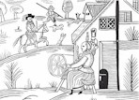
Textiles
Late 17th century: weaving and fulling
Paupers at workhouse taught spinning and weaving.
In 1790 Workman Brummell and Co. established a large cotton mill in the centre of Dartford on the site now occupied by Glaxo Wellcome.
building 6 or 7storeys high
workforce of > 400 boys.
unusual for a southern town and short-lived. After only 5 years of cotton production, the factory was accidentally destroyed by fire.
Matthias Wilkes erected the Phoenix Mills on the site in 1797 at a cost of £80,000; the mills specialised in the grinding of corn and the manufacture of linseed oil

Slide 26
What can we see today?

Slide 27
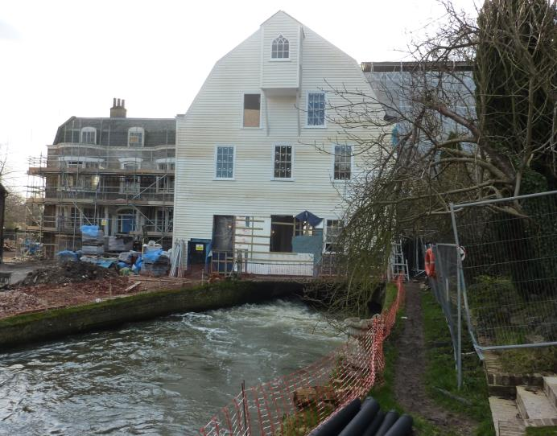
Farningham Mill

Slide 28
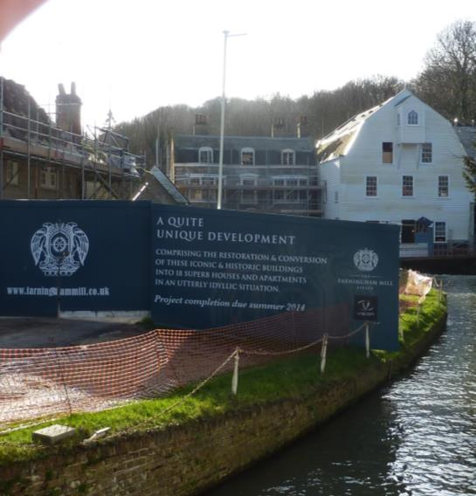
A quite unique development…?

Slide 29
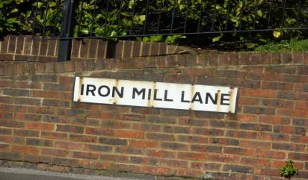
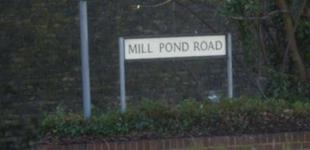
Street names tell of past industries
Mill Lane
Westerham
Sevenoaks
Shoreham
Eynsford
Cray
Dartford
Powder Mill Lane
Dartford
Mill Pond Close
Sevenoaks

Slide 30
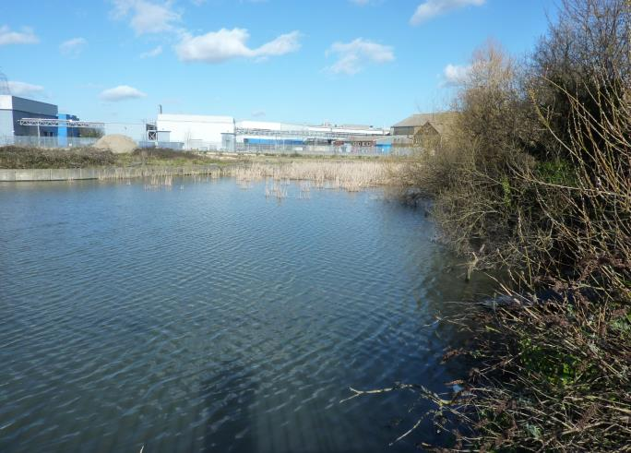
Mill Pond Road Dartford

Slide 31
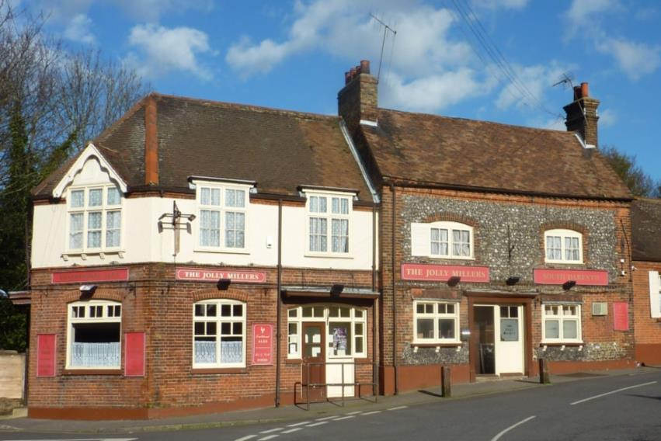
Pub names also reflect the past

Slide 32
Summary: Industries along the Darent
River Darent important as a source of water power and for access/transport for many centuries
A relatively short river ~21 miles
Mills initially used for local produce (corn mills, saw mills) and later for more industrial use in and around Dartford. Paper making and gunpowder very important.
Some raw materials obtained locally, chalk, wool, wood and some shipped in, saltpetre, sulphur, ore
Dartford important because close to London, access via River Thames and on main route to Canterbury and Kent coast

Slide 33
Thank you! Discussion

Slide 34
References
Wikipedia: en.wikipedia.org/wiki/River_Darent‎
Dartford town archive: www.dartfordarchive.org.uk/‎
For further information www.woodlands-junior.kent.sch.uk/river

