Slide 1
Cyber Crime
Aimee Payne
Cyber Protect & Prevent Officer
Serious Economic Crime Unit

Slide 2
Scale of issue
Estimated cost of Cybercrime is $450 Billion per annum globally
Largest part of internet not controlled
Offenders not constrained by geographical borders
Law Enforcement response hampered by differing legislation
Constantly developing technology
Notes:
1. Cyber crime is hard to estimate, but it is estimated at a cost of $445 Billion per annum globally, but we know that this is significantly higher.
2. Largest part of the Internet isn’t controlled, for example, Dark Web, unregulated and the users are anonymous, for example, now on both the dark and open web offenders are renting malware or offering to do Denial of Service attacks for hire.
3. Offenders can be anywhere (nationally or internationally)! They are not restricted to borders.
4. Law enforcements are bound by borders, legislation and information sharing agreements.
5. Technology is always evolving. We (as a Police Force) are restricted by rules around procurement, licences, budgets, therefore we are generally dealing with out of date systems and hardware when compared to the offender.

Slide 3
Fraud and Cyber data
Kent is 11th highest force in terms of fraud reports alone
In the 6 months from April 2017 – September 2017 there were 7,780 reports from Kent, accounting for over £14.8 million in losses
Business victims account for 70% of the reported crime above
Individuals account for 29% of the reported crime above
Biggest stand alone pure cyber crime is Ransomware
Notes:
1. Kent is 7th highest force in terms of fraud reports alone
2. In the 6 months from October 2016 – March 2017 there were 7,716 reports from Kent, accounting for over £15.5 million in losses
3. Business victims account for 58% of the reported crime above
4. Of the enablers recorded cyber is highest with 55%
5. Biggest stand alone pure cyber crime is Ransomware
6. It is estimated that only 29% of UK business have a cyber policy in place

Slide 4
Whenever we go online we leave a digital footprint and need to REMEMBER
Everything is stored somewhere
You have no control of it once you have shared it online or via a message
Much of it cannot be deleted
Anyone can find out about you
Are you happy for anyone to see everything about you?
How does this affect your reputation?
Who might use the information?
Total strangers?
Criminals?
Employers?
Stalkers?
The answer is … potentially all of them!

Slide 6
Take a few minutes to review your digital footprint…
Quite simply, Google yourself!
Also try searching yourself on www.pipl.com
Other steps to take :
Change Facebook settings make old Timeline posts visible only to you
Check that photos are not “publicly available”
Opt to approve photos and posts by others before they appear on your timeline
Delete any old social media accounts you no longer use
Spring clean and remove any posts that may not show you in a positive way
Notes:
Quite simply, Google yourself!
Also try searching yourself on www.pipl.com
Other steps to take :
Change Facebook settings make old Timeline posts visible only to you
Check that photos are not “publicly available”
Opt to approve photos and posts by others before they appear on your timeline
Delete any old social media accounts you no longer use
Spring clean and remove any posts that may not show you in a positive way

Slide 7
Password Security
Notes:
Just some thoughts around password security.

Slide 8
Be aware of data breaches & protect your data
www.haveibeenpwned.com
A website that allows you to check if your personal data has been compromised by data breaches.
"Notify me" service allows visitors to subscribe to notifications about future breaches. Once signed up, you will receive an email message any time their personal information is found in a new data breach.
This service often alerts users to breaches long before it reaches the
news, meaning that you can take action immediately instead of your accounts being at risk for months without you knowing.
Notes:
A website that allows you to check if your personal data has been compromised by data breaches.
"Notify me" service allows visitors to subscribe to notifications about future breaches. Once signed up, you will receive an email message any time their personal information is found in a new data breach.
This service often alerts users to breaches long before it reaches the news, meaning that you can take action immediately instead of your accounts being at risk for months without you knowing.

Slide 9
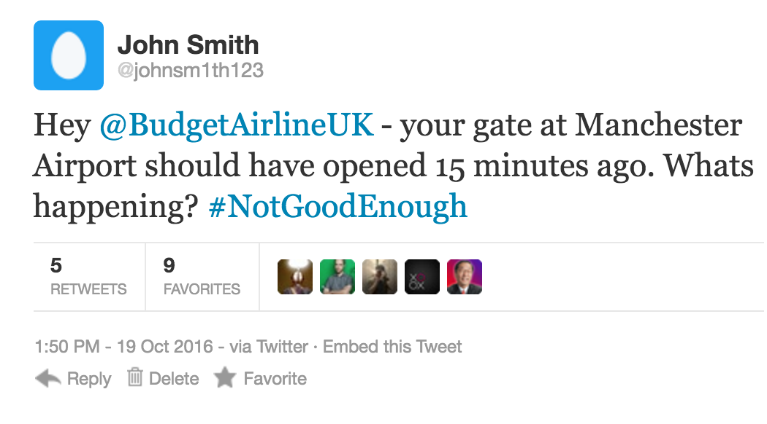
Social engineering
Sometimes the information we post onto social media can appear harmless and innocent, but it can often be used by cyber criminals to form part of an attack.
What information can we learn about someone from the post opposite? How could this information be used against us?
Notes:
Quite simply, Google yourself!
Also try searching yourself on www.pipl.com
Other steps to take :
Change Facebook settings make old Timeline posts visible only to you
Check that photos are not “publicly available”
Opt to approve photos and posts by others before they appear on your timeline
Delete any old social media accounts you no longer use
Spring clean and remove any posts that may not show you in a positive way

Slide 10
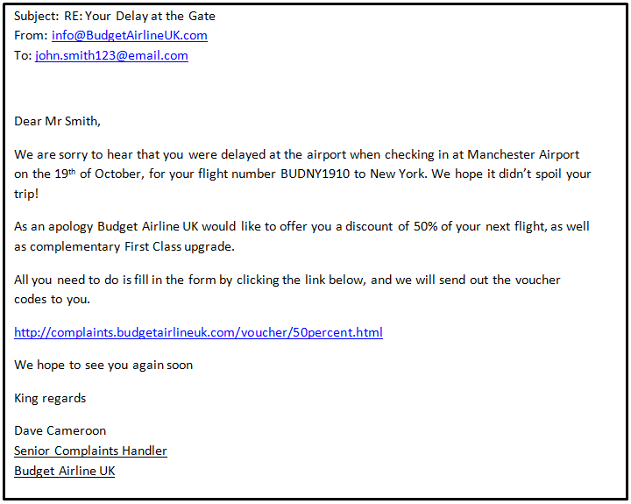
Social engineering
Notes:
Quite simply, Google yourself!
Also try searching yourself on www.pipl.com
Other steps to take :
Change Facebook settings make old Timeline posts visible only to you
Check that photos are not “publicly available”
Opt to approve photos and posts by others before they appear on your timeline
Delete any old social media accounts you no longer use
Spring clean and remove any posts that may not show you in a positive way

Slide 11
Types of threats

Slide 12
Ransomware

Slide 13
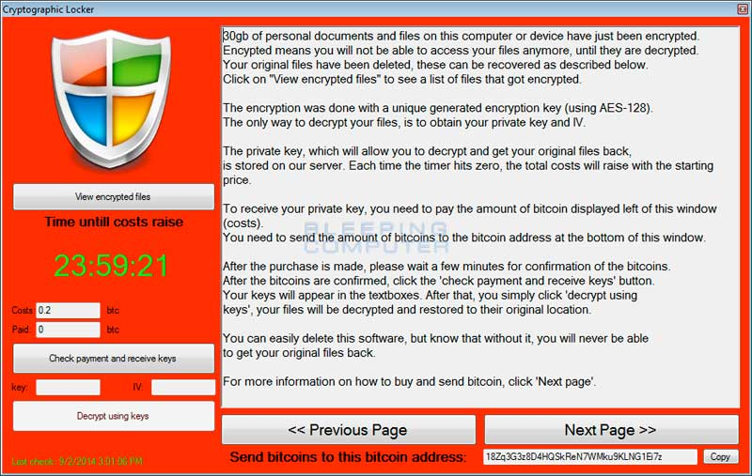
Notes:
This is a screenshot of a Ransomware.
What is Ransomware??
Ransomware is a form of malware that provides criminals with the ability to lock a computer from a remote location – then display a pop up window informing the owner or user that it will not be unlocked until a sum of money is paid.
Your computers could be infected by ransomware when you or colleagues inadvertently:
Open a malicious attachment in an email, Click on a malicious link in an email, instant message, social networking site or other website, Visit a corrupt website, Open corrupt macros in application documents (word processing, spreadsheets etc), Connect corrupt USB connected devices (eg memory sticks, external hard drives, MP3 players), Insert corrupt CDs/DVDs into computers.

Slide 14
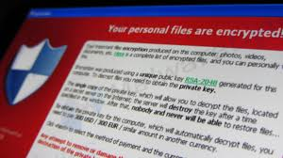
Beware Ransomware!
Malicious software (malware) that attempts to extort money (tokens/bitcoins generally)
The ransomware will either “lock” the computer to prevent usage, or will encrypt the files contained on it barring access to them
Ransomware generally occurs when a link in an email or and email attachment is opened allowing the ‘malware’ to be installed
ADVICE
Ensure you have regular back ups (non
cloud too) – but most importantly :
ALWAYS exercise extreme caution
with email links and attachments,
EVEN from trusted senders
Notes:
Malicious software (malware) that attempts to extort money (tokens/bitcoins generally)
The ransomware will either “lock” the computer to prevent usage, or will encrypt the files contained on it barring access to them
Ransomware generally occurs when a link in an email or and email attachment is opened allowing the ‘malware’ to be installed
Ensure you have regular back ups (non cloud too) – but most importantly :
ALWAYS exercise extreme caution with email links and attachments, EVEN from trusted senders

Slide 15
DDoS Distributed Denial of Service

Slide 16
Notes:
2. A Distributed Denial of Service (DDoS) attack is an attempt to make a network or website unavailable to its intended users, by using many, often thousands of systems to flood the targeted system with traffic. Its is similar to a group of people crowding the door of a shop preventing legitimate parties from entering.
These attacks may be undertaken by someone with a grudge against the business, or maybe will come with a ransom demand, or sometimes will be perpetrated by hackers with no particular motive or link to the business.

Slide 17
Phishing & Spear Phishing

Slide 18
Notes:
3. This is an example Phishing Email. Phishing emails are designed by fraudsters to appear as if they have been sent by banks, credit card companies, government departments, and other trusted organisations, this is to trick you into either, clicking the link or opening the attachment to get confidential information or affect your systems with Malware. Some examples of a Phishing email maybe;
The sender’s email address may be different from the trusted organisation’s website address.
The email may not use your proper name, but uses a non-specific greeting such as “Dear customer.”
It may contain misspelt words and poor grammar.
A sense of urgency; for example the threat that unless you act immediately your account may be closed.
A request for personal information such as username, password or bank details.
You weren't expecting to get an email from the organisation that appears to have sent it.

Slide 19
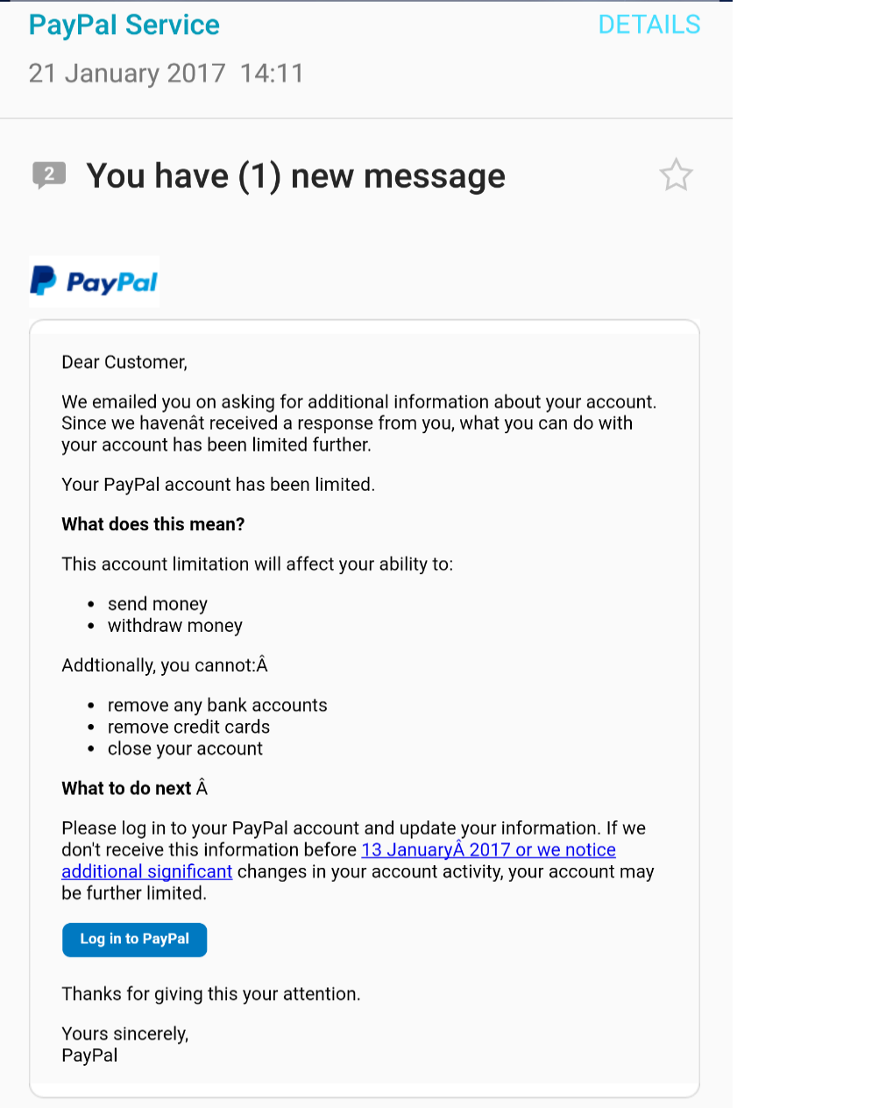
Seeing is not necessarily believing!
Looks very authentic, doesn’t it?
1. Generic Greeting
2. Mistake – date missed out
3. Urgency/threat – Classic sign!
4. Symbols?
5. Incorrect date
6. Poor grammar
Notes:
Looks very authentic, doesn’t it?
1. Generic Greeting
2. Mistake – date missed out
3. Urgency/threat – Classic sign!
4. Symbols?
5. Incorrect date
6. Poor grammar

Slide 20
Notes:
The hacker will target a company, an by using social networks, they employees with access to company and data/systems
They will then follow a social trail, they will identify other people the employee may know
A fake by recognisable email address is created (known as spoofing) to impersonate a colleague or boss
A personalised email is sent to the employee from the fake address with a link or attachment
The email passes through the spam filter and arrives at the employee’s inbox
The email is then opened because they “know “ the sender
A link is clicked or attachment is then opened
8a. Opened website causes credentials to be stolen/malware to be installed
8b. Opened attachment causes malware to infect the computer /network
The Hacker uses the backdoor to steal the information!

Slide 21
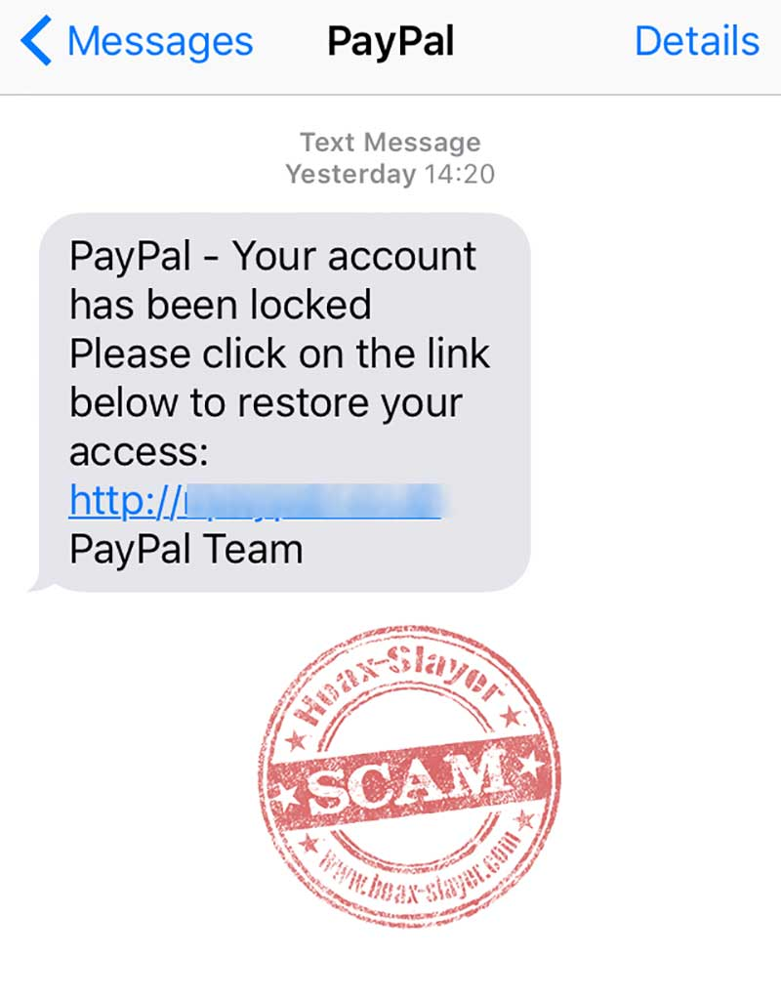
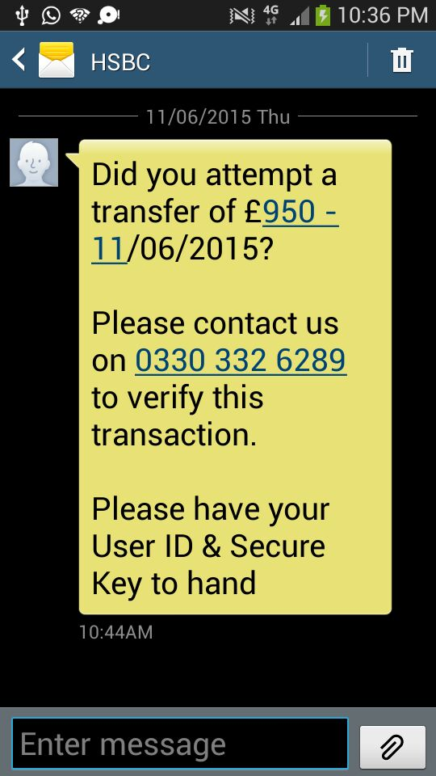
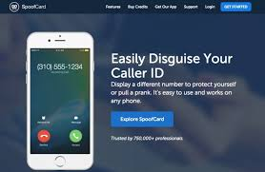
And it’s not just emails ….
… and not just SMS …
calls can be spoofed too

Slide 22
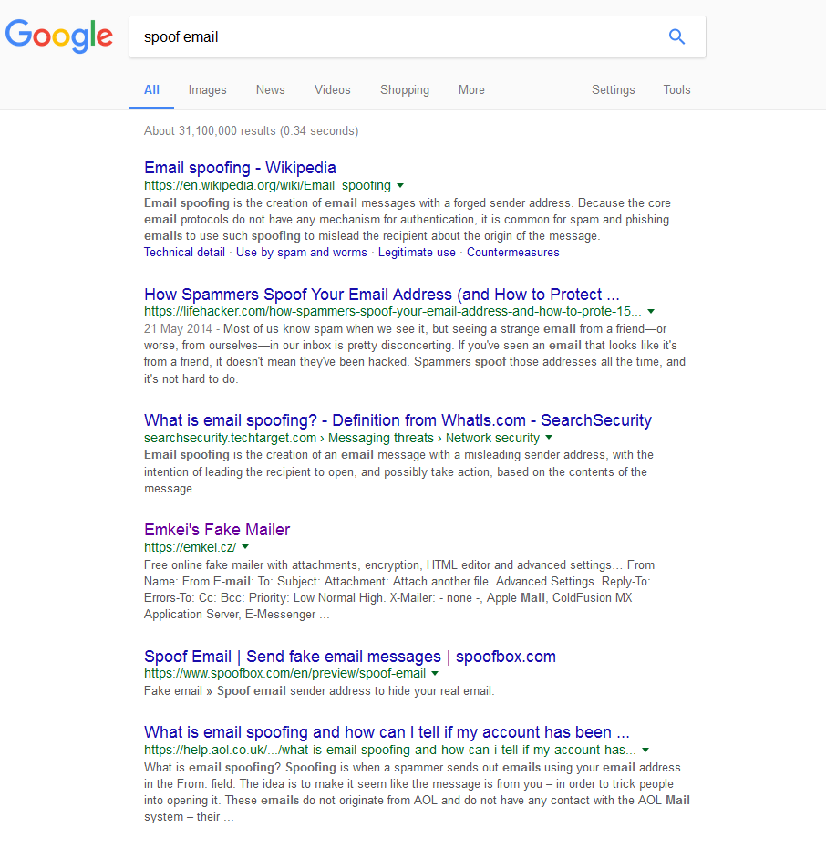
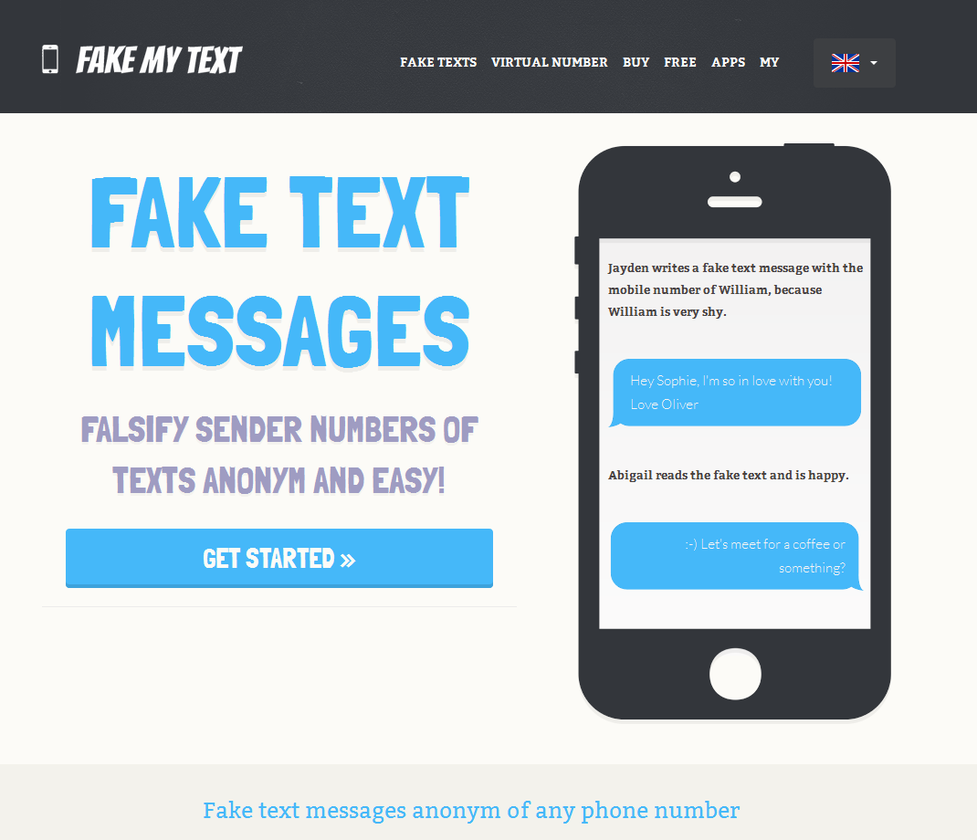
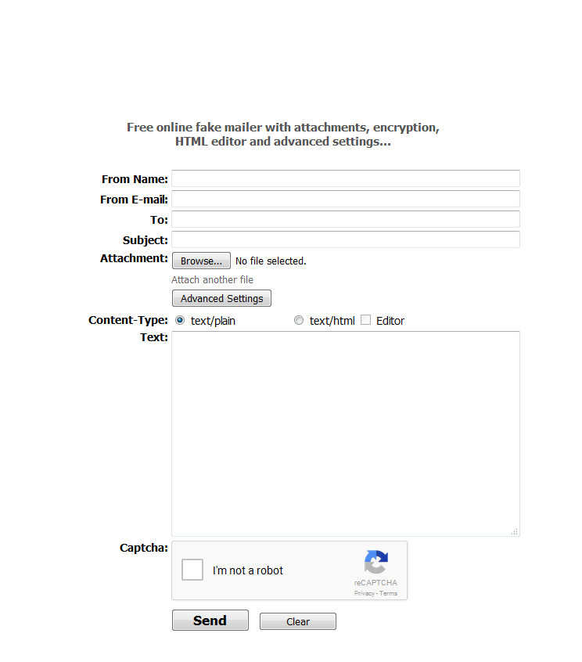
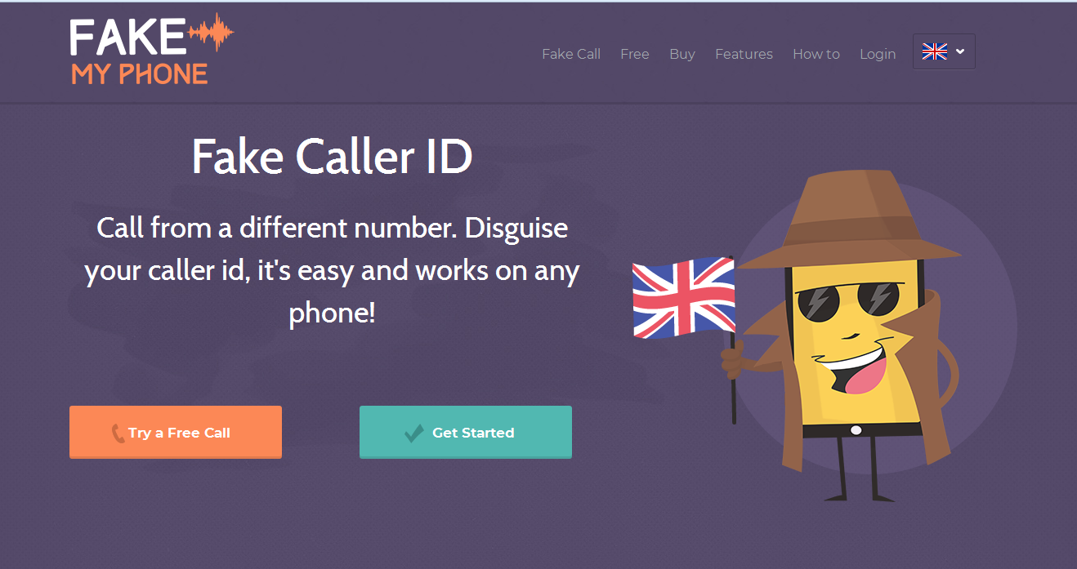

Slide 23
Other threats in Kent:
Computer Software Service Fraud
Mandate Fraud or CEO Fraud

Slide 24
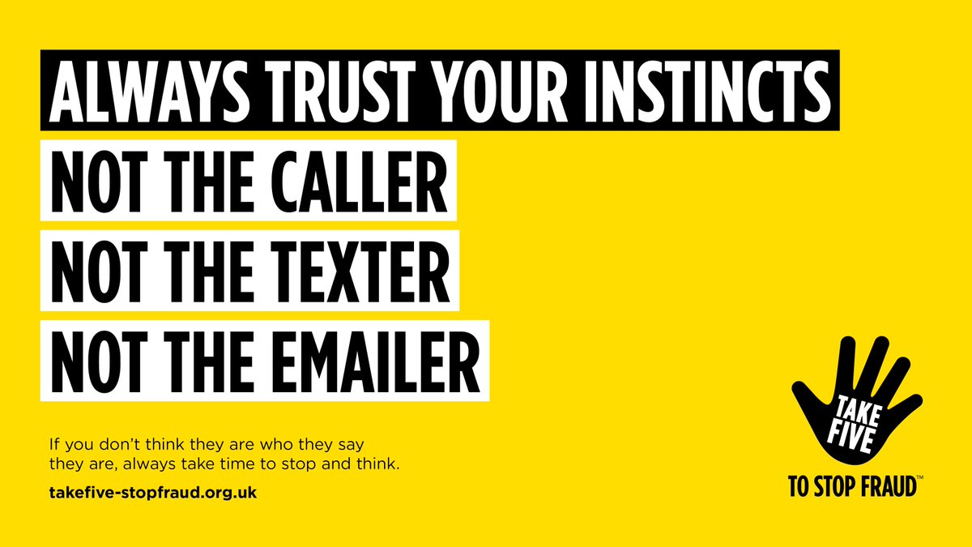

Slide 25
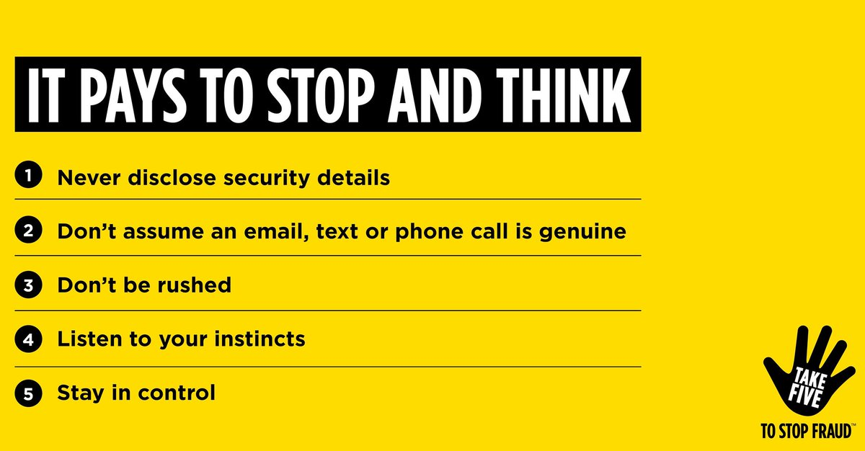
www.takefive-stopfraud.org.uk

Slide 26
Password Security
Notes:
Just some thoughts around password security.

Slide 28
Notes:
Just some thoughts around password security.

Slide 29
Current best practice advises THREE RANDOM WORDS. To add complexity, convert some letters to numbers and add special characters
For example : BEACHBUCKETSPADE
To add complexity : 8EACH8UCK3TSP4DE£
Your single most important account and password is your email – effectively, anyone taking control of your email can then reset all your other passwords locking you out.
Don’t use words/names/information that may be in the public domain or easily worked out from social media content, such as Mother’s maiden name; Date/Place of birth; pets names; children’s names; teams you support etc
Never share passwords or disclose your password to anyone else
Always change default passwords on all SMART devices/routers
ALWAYS log out of sites you have logged in to – especially on shared/public devices/machines
Notes:
Current best practice advises THREE RANDOM WORDS. To add complexity, convert some letters to numbers and add special characters
For example : BEACHBUCKETSPADE
To add complexity: 8EACH8UCK3TSP4DE£
Your single most important account and password is your email – effectively, anyone taking control of your email can then reset all your other passwords locking you out.
Don’t use words/names/information that may be in the public domain or easily worked out from social media content, such as Mother’s maiden name; Date/Place of birth; pets names; children’s names; teams you support etc
Never share passwords or disclose your password to anyone else
Always change default passwords on all SMART devices/routers
ALWAYS log out of sites you have logged in to – especially on shared/public devices/machines

Slide 30
Notes:
Nothing is ever free……………..
We all use this more and more. The football results can not wait, need to update my 20 friends and the 500 people I don’t really know that I’m eating a sandwich.
Need to work on the go, check and send emails, but I don’t want to pay for it.
Would you leave your home insecure or the front door of your business open overnight???
Would you leave a stranger with your bank card and pin to keep your money safe??
You take the same risks with public wifi – but you do it anyway… This also applies to Bluetooth

Slide 31
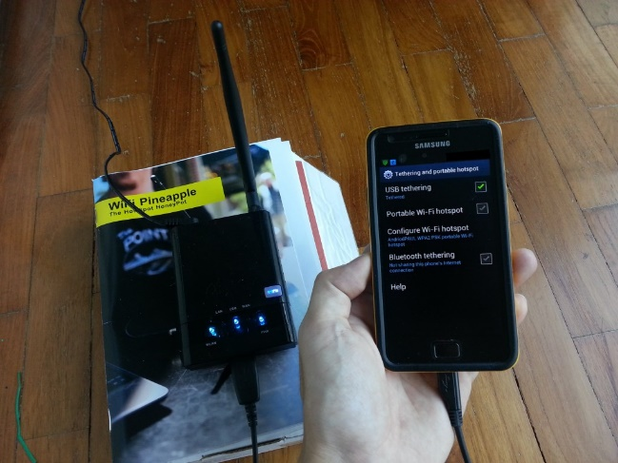
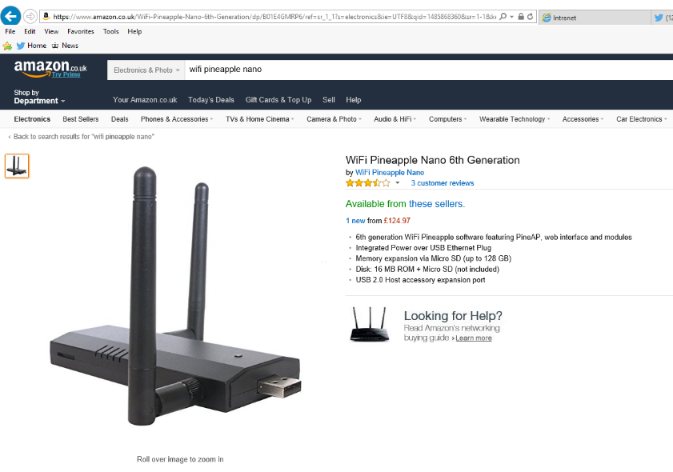
Did you know…
Any device connected to a Wi-Fi hotspot can view traffic sent & received by everyone else?
A malicious hacker could sit in a coffee shop and carry out all manner of attacks to intercept data as unsuspecting customers access online banking or chat on social media
Enterprising criminals can even set up their own hotspots with the primary goal of capturing personal data.
Notes:
Any device connected to a Wi-Fi hotspot can view traffic sent & received by everyone else?
A malicious hacker could sit in a coffee shop and carry out all manner of attacks to intercept data as unsuspecting customers access online banking or chat on social media
Enterprising criminals can even set up their own hotspots with the primary goal of capturing personal data.

Slide 32
How to protect yourself

Slide 33
Download software updates
Download software and app updates as soon as they appear. They contain vital security upgrades that keep your devices and business information safe.
Use strong passwords
Use strong passwords made up of at least three random words. Using lower and upper case letters, numbers and symbols this will make your passwords even stronger. Don’t post password answers on social media – pets names etc. And always change default password/PIN settings.
Delete suspicious emails
Delete suspicious emails as they may contain fraudulent requests for information or links to viruses.
Notes:
Download software and app updates as soon as they appear. They contain vital security upgrades that keep your devices and business information safe.
2. Use strong passwords made up of at least three random words. Using lower and upper case letters, numbers and symbols this will make your passwords even stronger. Don’t post password answers on social media – pets names etcAnd always change default password/PIN settings.
3. Delete suspicious emails as they may contain fraudulent requests for information or links to viruses.

Slide 34
Use anti-virus software
Your computers, tablets and smartphones can easily become infected by small pieces of software known as viruses or malware. Install creditable internet security software like anti-virus on all your devices to help prevent infection. And remember to switch it on!
Be Aware
Knowledge of Cyber Crime and the threats that you face, can massively reduce you becoming a victim
VPN’s
Don’t use public WIFI, if you choose to use it, consider using a VPN or just use 3/4G
Notes:
Use Anti – virus software, Your computers, tablets and smartphones can easily become infected by small pieces of software known as viruses or malware. Install creditable internet security software like anti-virus on all your devices to help prevent infection. And remember to switch it on!
2 Train your staff, Make your staff aware of cyber security threats and how to deal with them. Conduct regular online safety and information security awareness for ALL employees. Get staff to question and challenge things that seem irregular. Set guidelines with your staff around accessing social media to help prevent your business being compromised.
3. Business Practices Cyber Essentials is a Government backed scheme setting out several practices necessary to be approved as a Cyber Essential company.
Consider making having Cyber Essentials mandatory in companies you contract with.

Slide 35
What happens if I become a victim of cybercrime?
Action Fraud – 0300 123 2040
Reporting a live cyber attack:
If you represent a business, charity or other organisation which is currently suffering a live cyber attack and data is potentially at risk, please call 0300 123 2040. This service is available 24 hours a day to report and get advice on what to do next. Please note, if you are member of the public you must report to us through our core opening hours or online.
Urgent Incidents – 999 or 101 (local Force response)
Non urgent incidents – 101 (in office hours local cybercrime unit)/ Action Fraud

Slide 36
Useful Websites:
National Cyber Security Centre:
www.ncsc.gov.uk
Online safety on all areas for everyone :
www.getsafeonline.org
General advice on Cyber Security for Business & Public :
www.cyberaware.gov.uk

Slide 37
Checklist :
❒ | Check Op Systems are supported and running the latest version
❒ | Check Firewalls, Antivirus, Antimalware and Antispyware installed and running
❒ | Check your passwords are secure enough and not used across platforms
❒ | Check your digital footprint
❒ | Check UK Phonebook & 192.com for entries in your name – request removal
❒ | Check your social media settings
❒ | Check your email address with www.haveibeenpwned.com
❒ | Ensure your home router has a password set, if the original default, change it
❒ | Don’t use public WiFi for sensitive transactions such as banking/social media/email unless you’ve set up a VPN, or revert to 3G/4G on your device
❒ | Share this information with family, friends, and the public!

Slide 38
QUESTIONS ?
Aimee Payne
Cyber Protect Officer
Serious Economic Crime Unit
Kent & Essex Serious Crime Directorate
Direct Dial: 01622 654322
aimee.payne@kent.pnn.police.uk
Twitter - @kentpolicecyber

